Slide 1

GuideSense
Your Trusted Navigation Companion
Team: Power Angers
Sprint 3

Slide 2
Agenda
1
2
3
Team Member
Sprint 2 Recap
9
Improvements
Product backlogs
10
Project Overview
Sprint Summary
11
4
Sprint 3 Matrics
Technologies & Tools
12
5
Sprint 3 Test Cases
Team Logistics
13
Personas
Retrospective
6
14
MVP
Project Demo
7
15
Designed Diagrams
API codes explanation
8
16

Slide 3
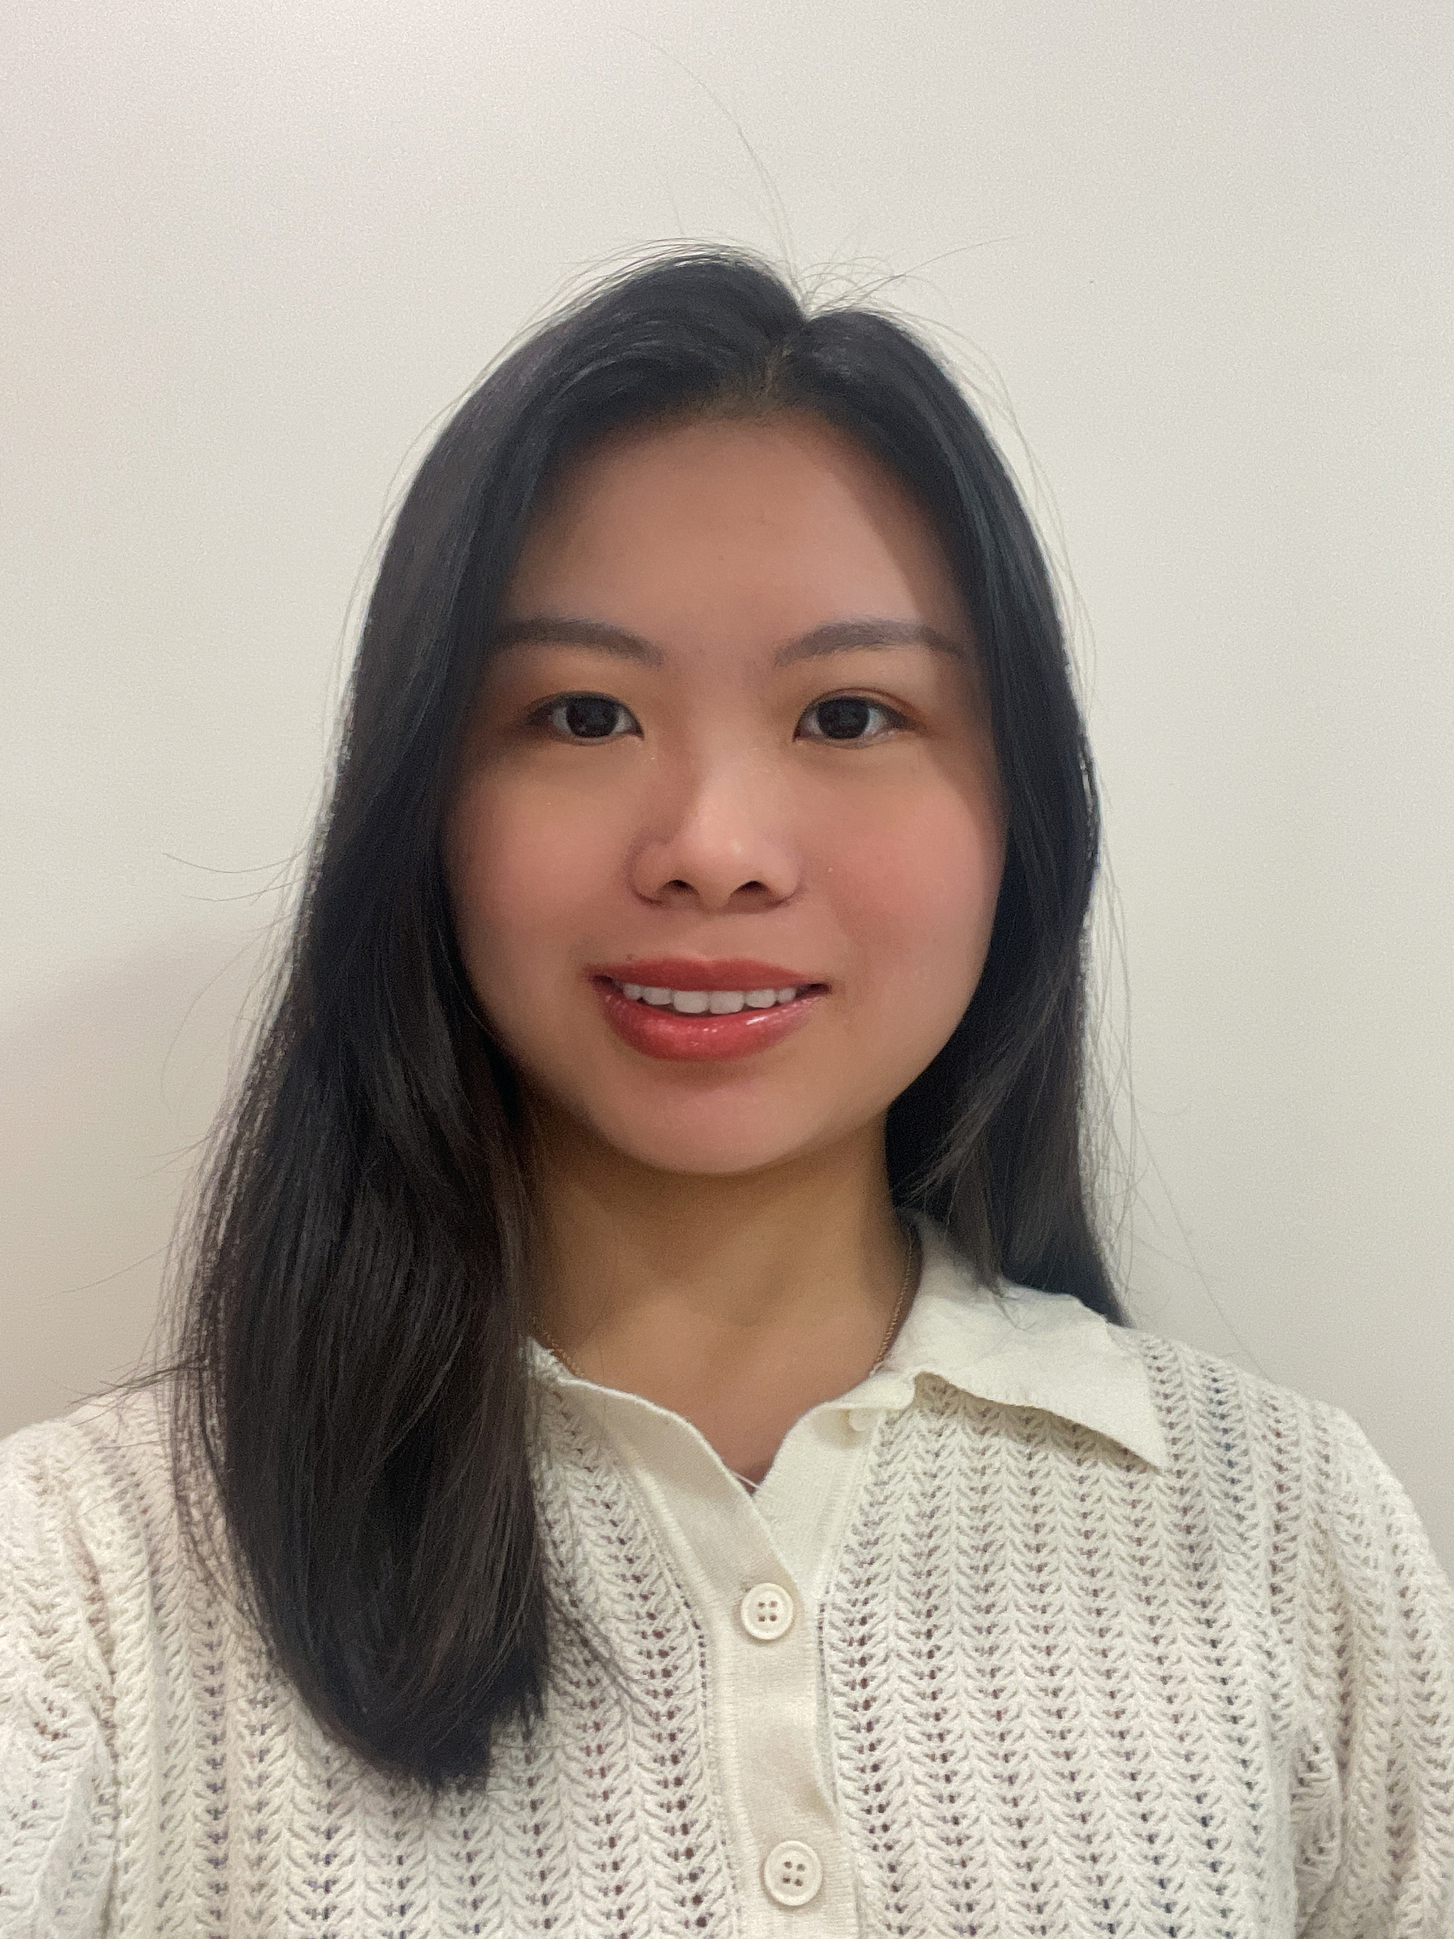

Power Anger
Afziya Waknis
Kaiyin Chen
Project Manager/
Developer
Aw14091n@pace.edu
Database Administrator
Kaiyin.chen@pace.edu

Slide 4
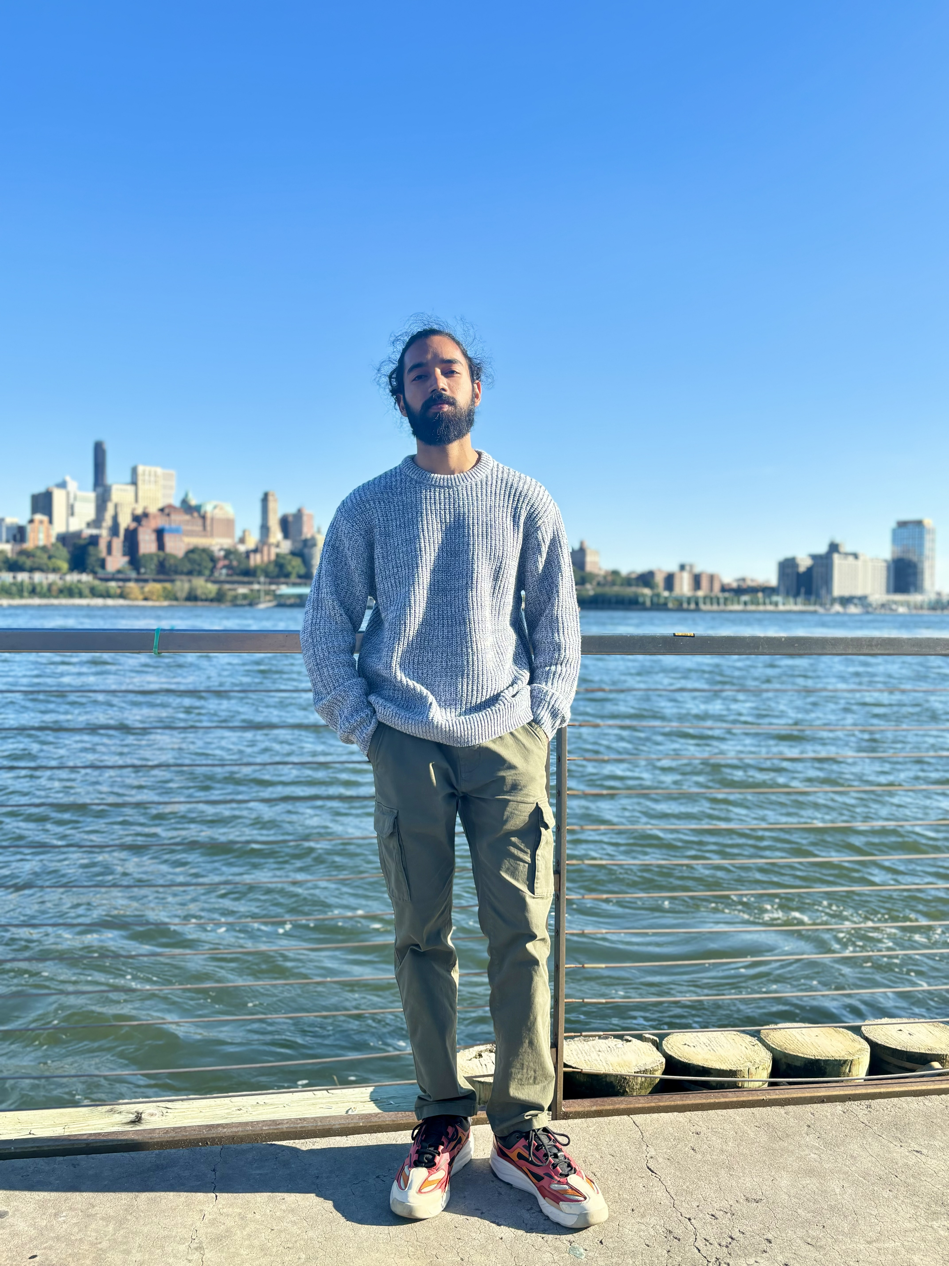

Power Anger
Ritesh Singh
Dinesh Gopi Sunkara
Devops Engineer
Ritesh.singh@pace.edu
Developer
Ds46669n@pace.edu

Slide 5
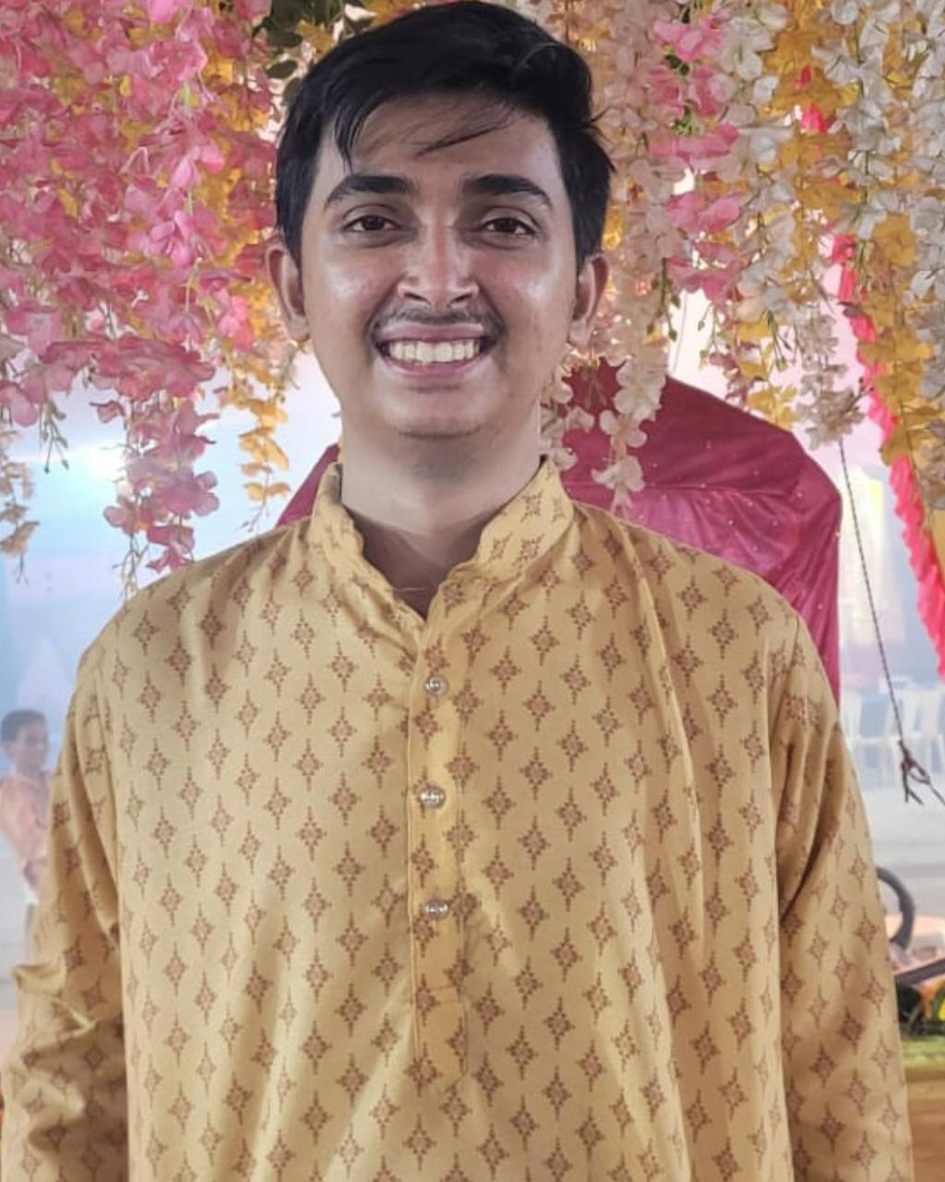
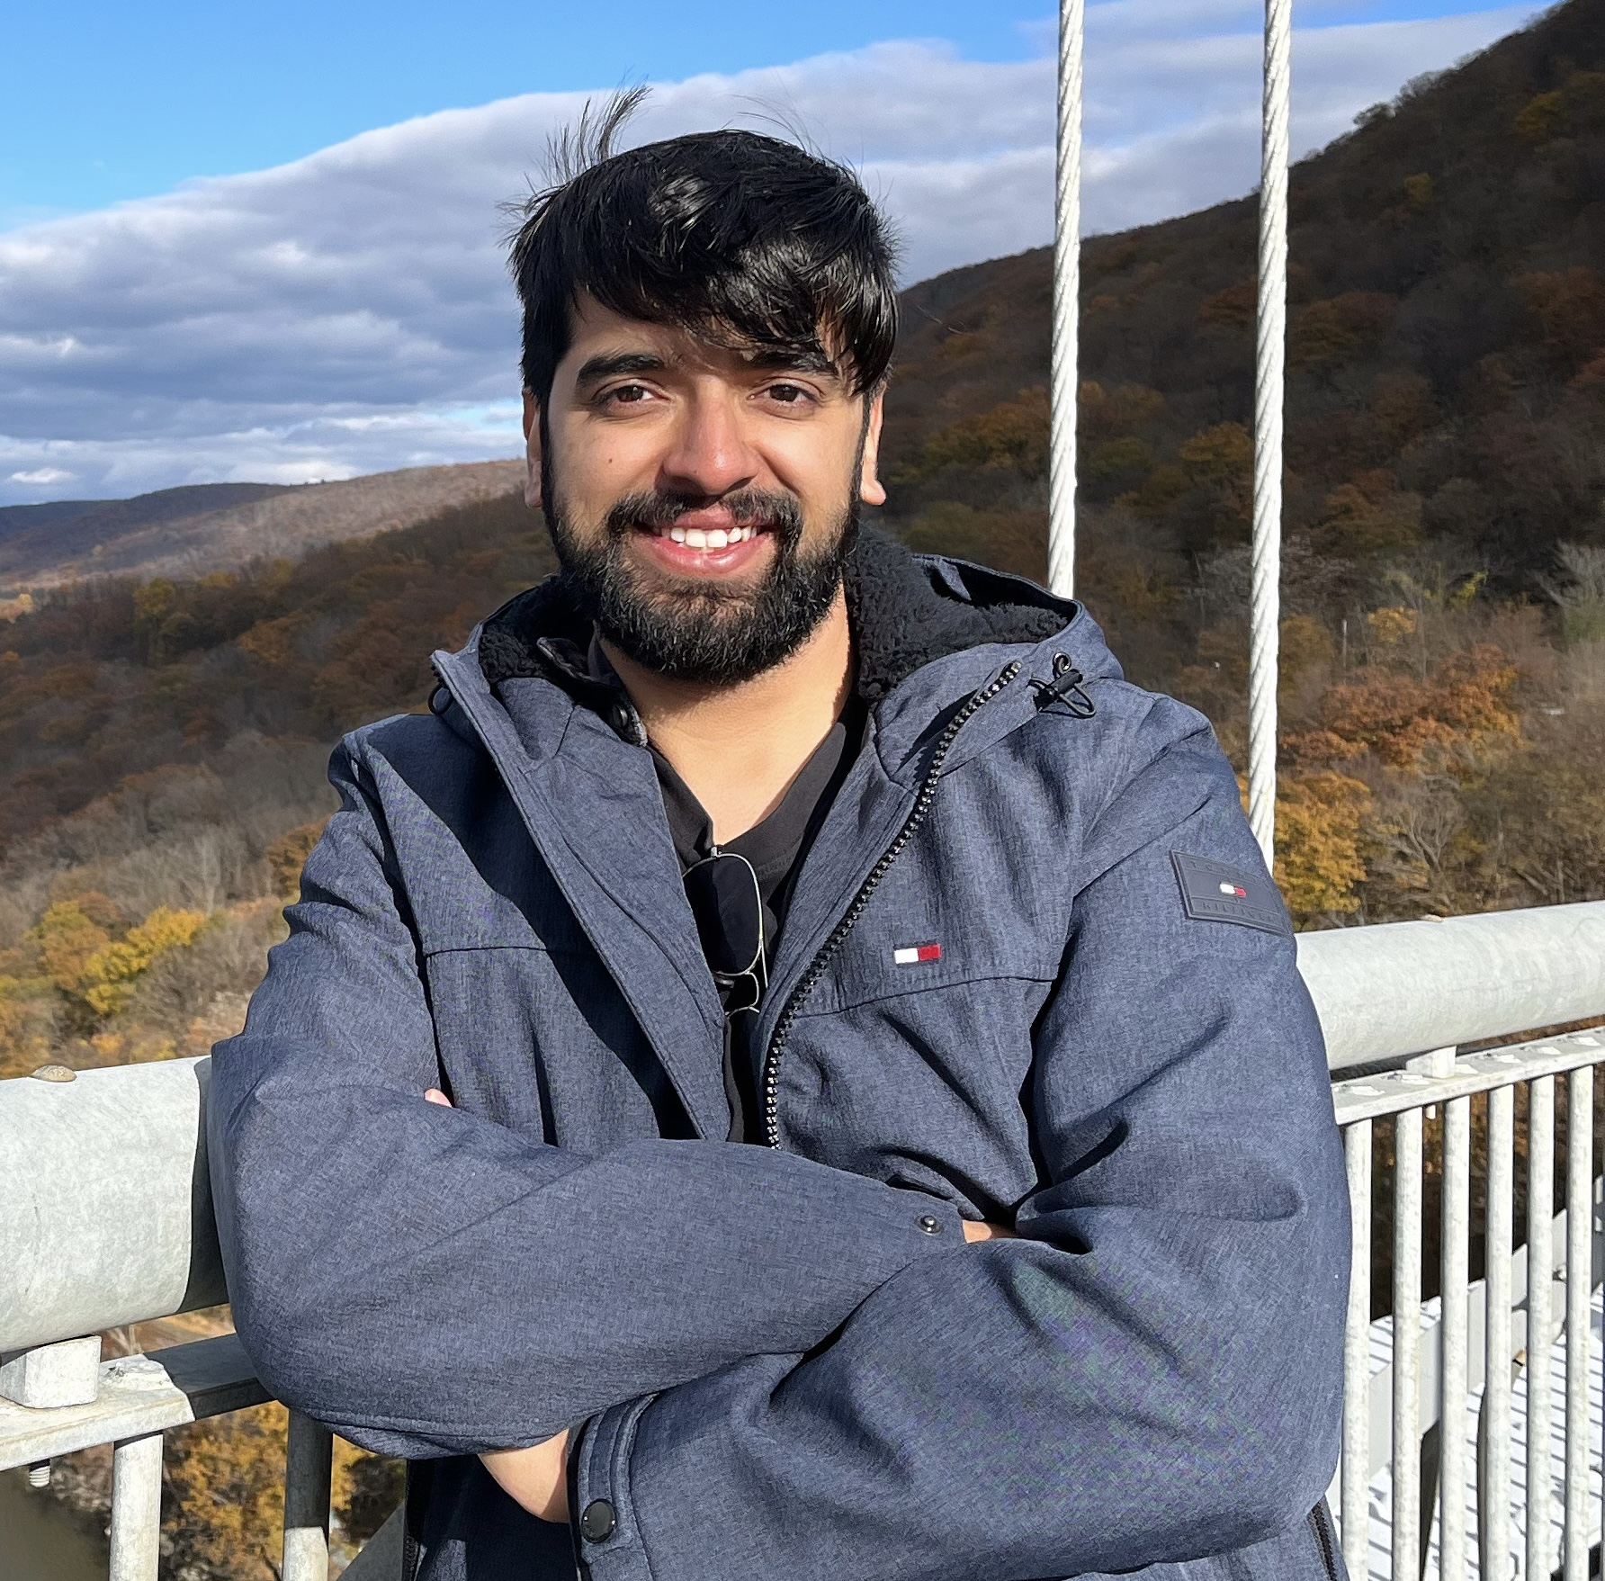
Power Anger
Rushabh Makwana
Vaibhav Thapliyal
Developer Lead
Frontend Developer
Vaibhav.thapliyal6@gmail.com
Backend Developer
Rm36294n@pace.edu

Slide 6
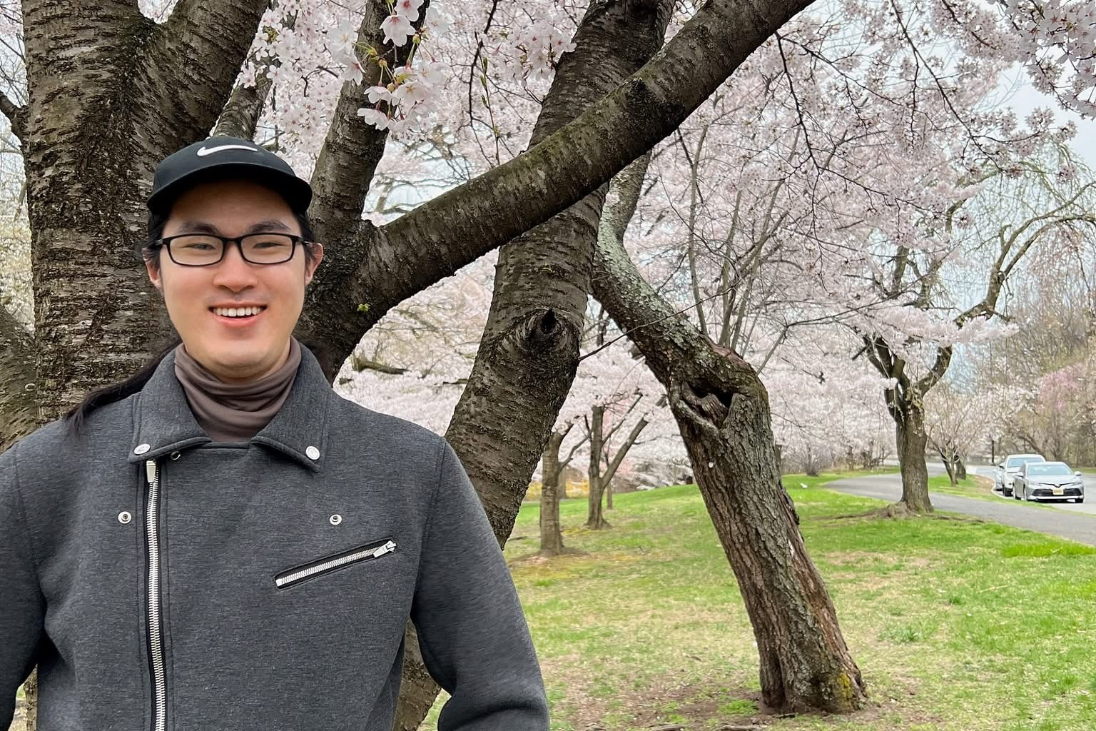
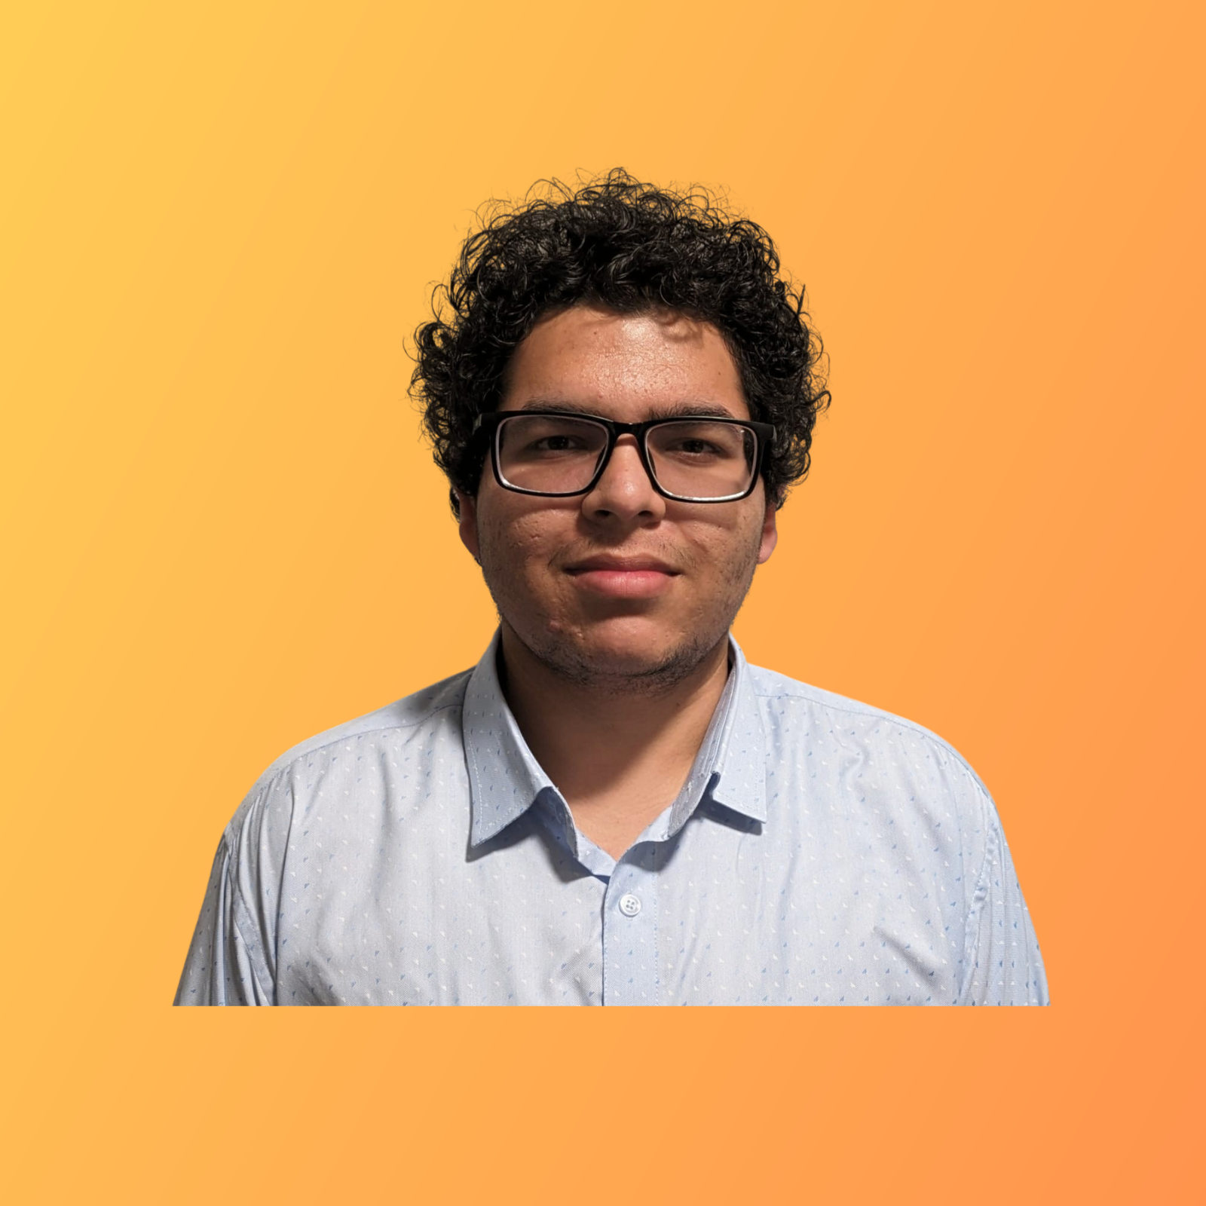
Power Anger
Min Jung
Hrishikesh Shah
Quality Analyst
Mj34564n@pace.edu
Frontend Developer
Hs75142n@pace.edu

Slide 7
Improvements
User stories (US1, US7)
Burndown chat (Slide 39)
Code Demo Video
Retrospective Video
API code explanation(Slides 52-54)

Slide 8
Problem Statement
Navigating through everyday environments presents significant challenges for blind and visually impaired individuals., moving vehicles, and the lack of real-time guidance.
Traditional mobility aids like canes and guide dogs, while helpful, often fall short in providing comprehensive and real-time information about obstacles, directions, and surroundings.
This lack of real-time situational awareness can lead to increased risks of accidents and restrict the independence of visually impaired individuals.
Therefore, there is a pressing need for an innovative solution that leverages modern technology to enhance mobility and safety for the visually impaired community.
This project aims to create a web app that uses object detection and voice commands to help blind people navigate safely by warning them about obstacles, giving directions, and describing their surroundings in real time.

Slide 9
Project Description (improved)
Project Name: | GuideSense
Team: | Power Angers
Project Description: | For visually impaired individuals who need assistance navigating independently in urban and outdoor environments, the real-time object detection web app is a computer vision and AI-powered solution that identifies objects, obstacles and crosswalks while providing real-time audio guidance and GPS-based navigation support. Unlike traditional mobility aids or existing navigation apps that lack real-time object detection, our application offers a seamless, intelligent, and accessible way for visually impaired users to navigate confidently.
Benefit Outcomes: | Increased Independence, Enhanced Safety, Improved Mobility, Greater Confidence, Accessibility, and Inclusivity.
GitHub Link: | https://github.com/htmw/2025S-Power-Anger/wiki

Slide 10
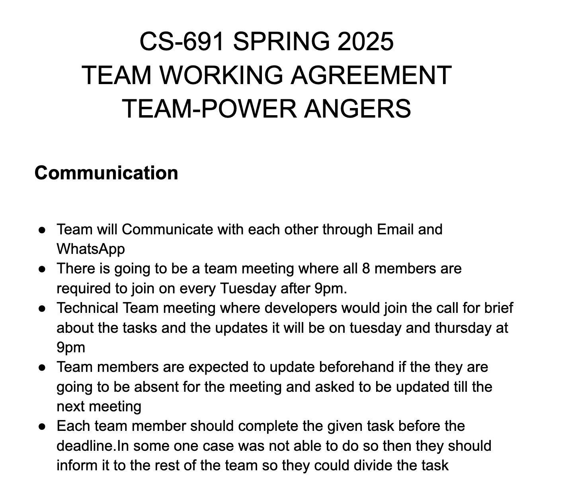
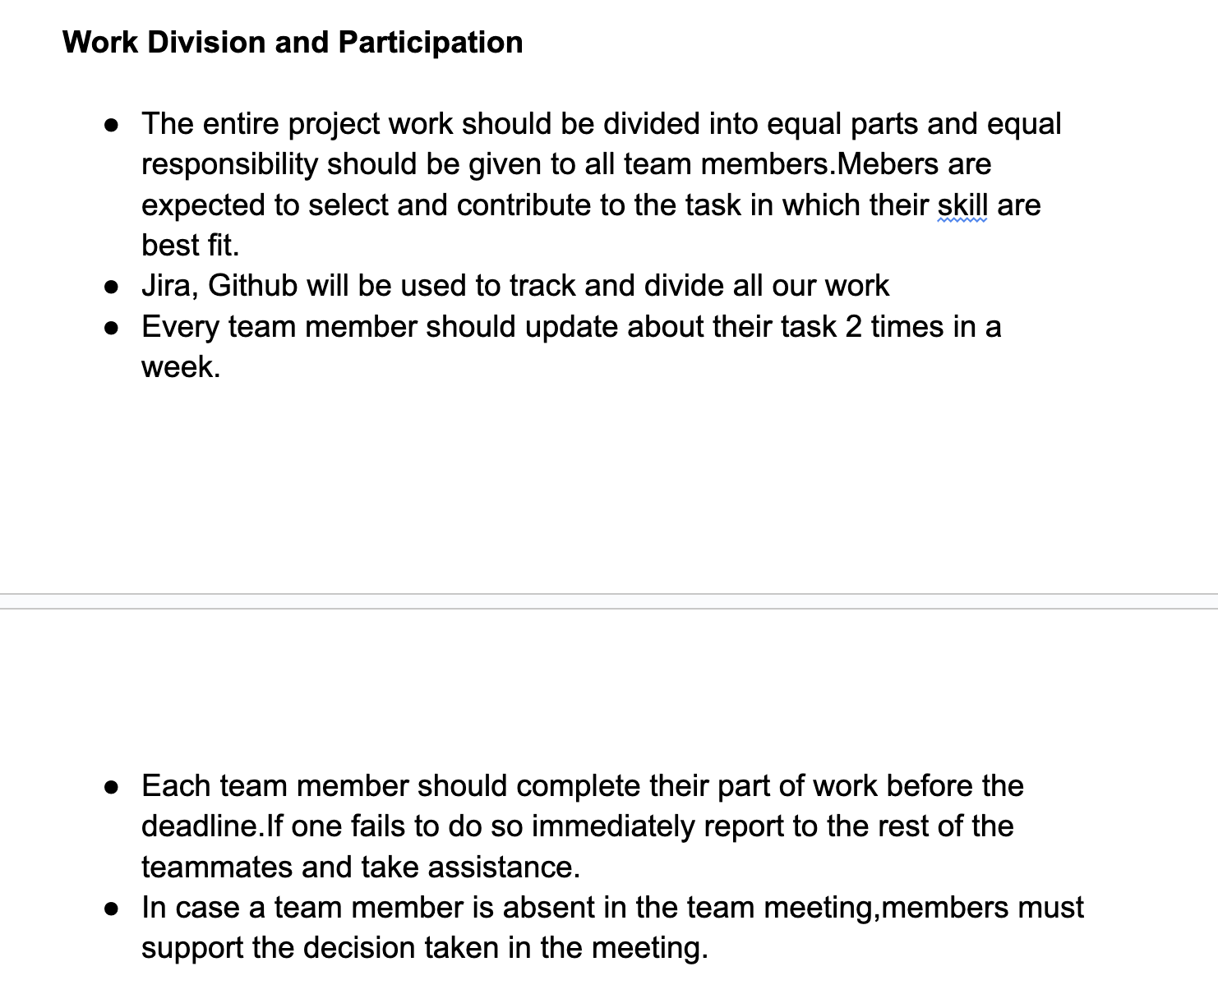
Team Working Agreement

Slide 11
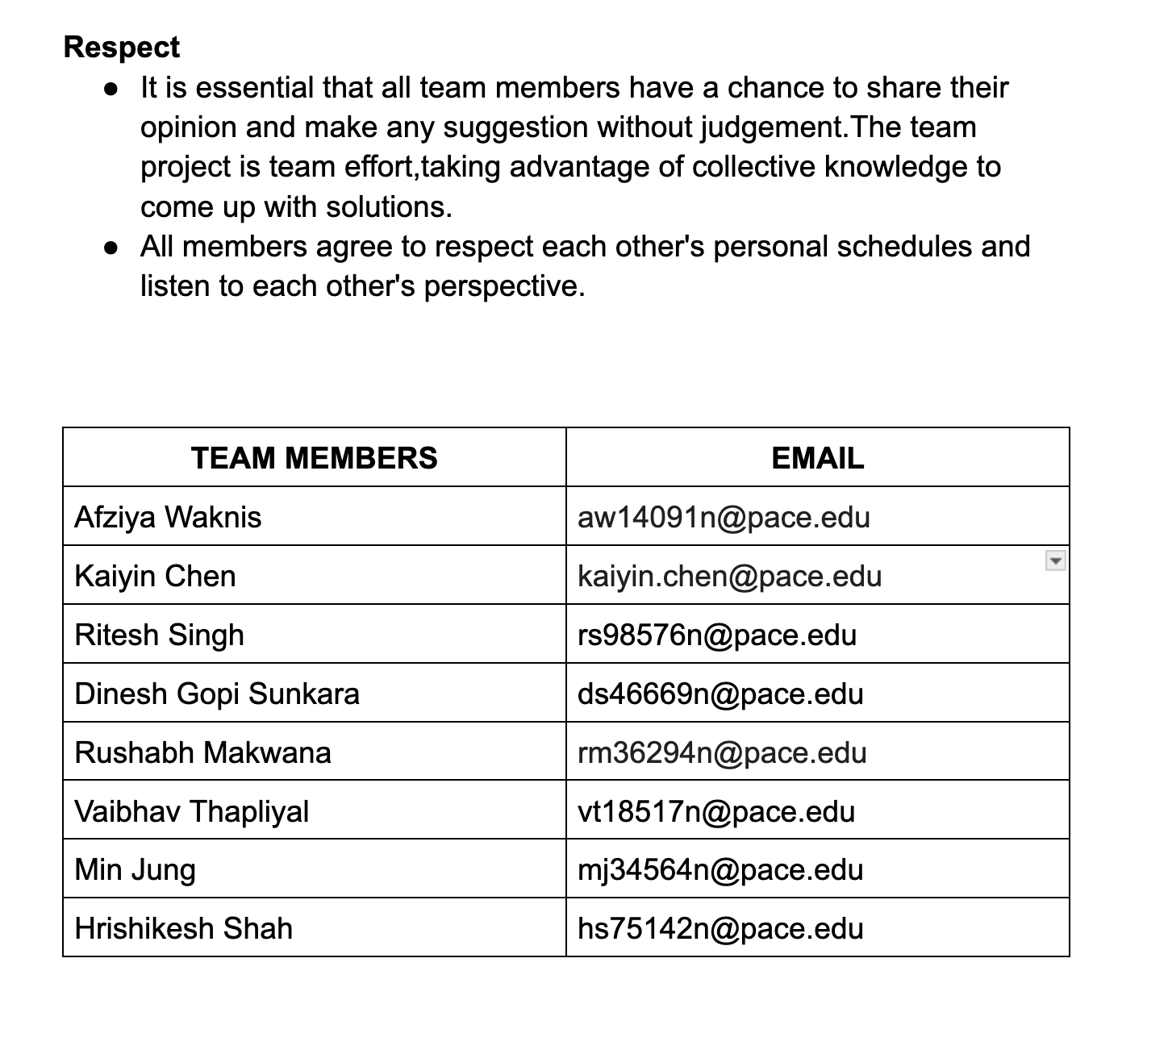
Team Working Agreement

Slide 12

Persona One: The Independent Blind User
Name: Aisha Khan
Age: 32
Occupation: Software Developer (works remotely)
Background: Aisha has been blind since birth. She is highly tech-savvy and relies on assistive technology. She is motivated to use tools that enhance her independence and streamline daily activities.
App Usage Scenario: Aisha wants to use the app for navigation while walking, especially in unfamiliar areas, and identify objects which could be a barrier for seamless tasks.
Needs: Seamless integration with existing assistive technologies (screen readers, voice control), accurate location services, reliable information about accessible routes and environments, and robust privacy features.
Goals: Increased independence, improved access to information, enhanced safety while navigating, and streamlined daily task management.

Slide 13
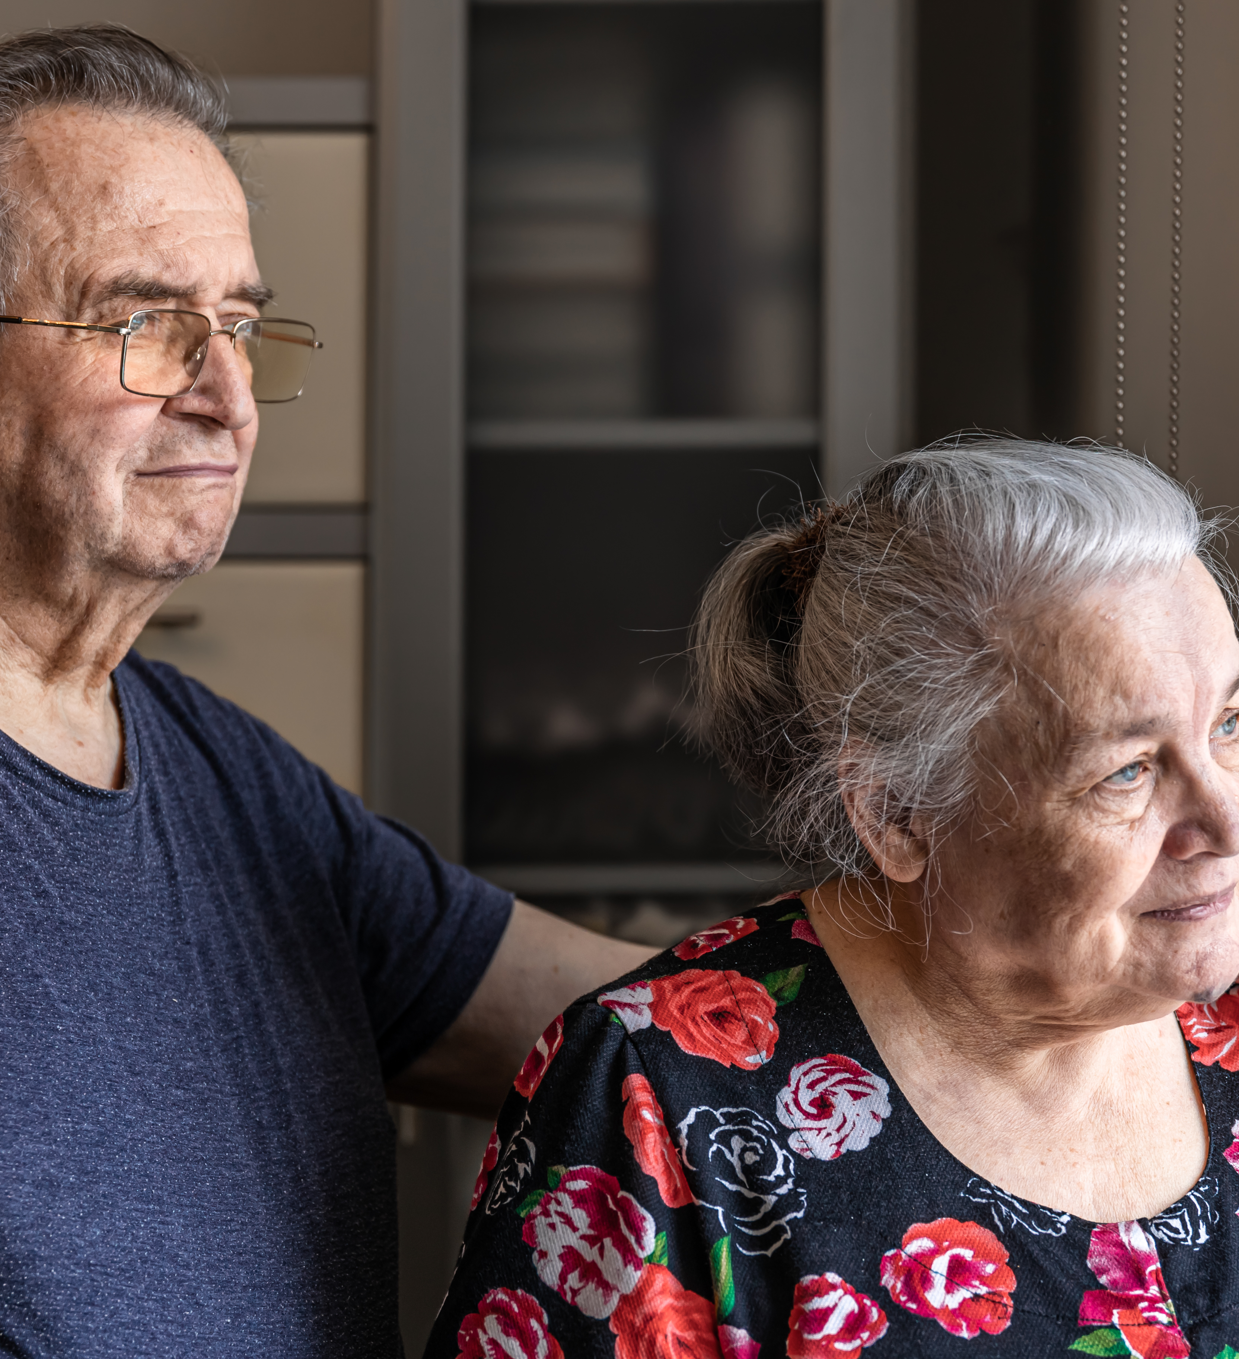
Persona Two: The Concerned Family Member
Name: Robert Chen
Age: 65
Relationship: Son of a visually impaired senior
"I worry about my mother's safety. I hope this app can help me stay connected and ensure she's doing okay."
Background: Robert's mother is losing her vision due to macular degeneration. He lives in a different city and wants to stay connected and provide support remotely.
App Usage Scenario: Robert wants to use the app to track his mother's location (with her consent), receive alerts if she deviates from her usual routes, remotely assist her with tasks like medication reminders, and communicate with her easily through the app's accessible interface.
Needs: User-friendly interface, reliable location tracking (with privacy safeguards), remote assistance features, accessible communication tools, and clear instructions for setup and use.
Goals: Increased peace of mind, improved communication with his mother, ability to provide remote support, and enhanced safety for his visually impaired parent

Slide 14
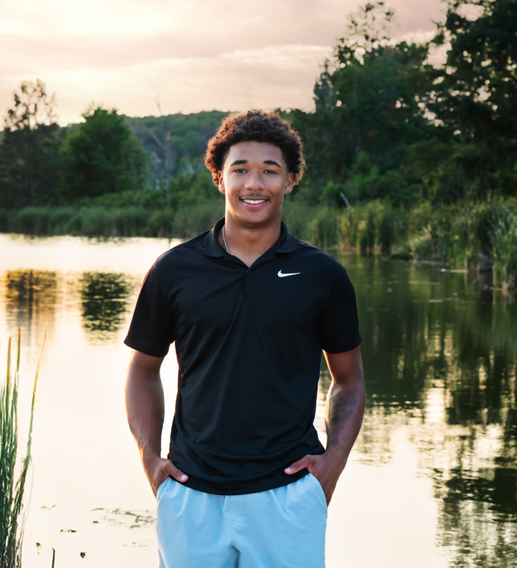
Persona Three : Partially sighted Teenager
Name: David Miller
Age: 16
Background: David has low vision due to a genetic condition. He can see some things with the aid of glasses or magnifiers.
"I want to be able to do the same things my friends do. I hope this app can help me navigate more easily and access information."
App Usage Scenario: David wants to use the app to magnify text and images, identify colors, navigate public transportation, and access audio descriptions of videos and other media. He needs an app that is easily customizable to his specific visual needs.
Needs: Customizable display settings (font size, contrast, color schemes), reliable object and text recognition features, seamless integration with magnification tools, and accessible interface that can be used with limited vision.
Goals: Increased independence, improved access to information, enhanced social participation, and greater confidence in navigating the world.

Slide 15
MVP
A client (web browser) connects to the server and sends a WebRTC offer
The server sets up a peer connection, processes the offer, and sends back an answer
When video starts streaming from the client, each frame is: - Received by the server - Processed through YOLO (object detection) - Enhanced with visual indicators (boxes around objects) - Sent back to the client in real-time

Slide 16










Technologies & Tools (improved)
NodeJs: RunTime
React: Frontend
Python: Object Detection
Clerk: Authentication
MongoDB: Database
AWS: Deployment
Jira: Project Management
GitHub: Code Versioning
OneDrive: File Sharing
IdeaBoardz: Sprint Retrospective

Slide 17
AI Model
YOLO, which stands for ‘You Only Look Once,’ is a state-of-the-art object detection model known for its real-time speed and accuracy.
Real-time Speed: Processes the entire image in a single pass, making it one of the fastest models for object detection.
Grid-Based Detection: Divides the image into a grid, with each cell responsible for detecting objects within it.
Accurate Bounding Boxes: Predicts precise bounding boxes and confidence scores for each detected object.
Pre-trained on COCO: Leverages the massive COCO dataset (80 object categories, 200,000+ images) for robust and accurate general object detection
Refined Results: Uses Non-Maximum Suppression (NMS) to eliminate overlapping detections and ensure only the most accurate results are shown.

Slide 18
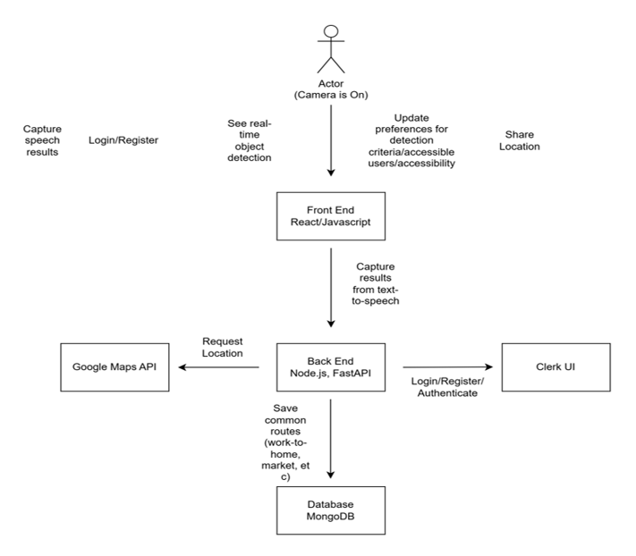
Architecture Diagram

Slide 19
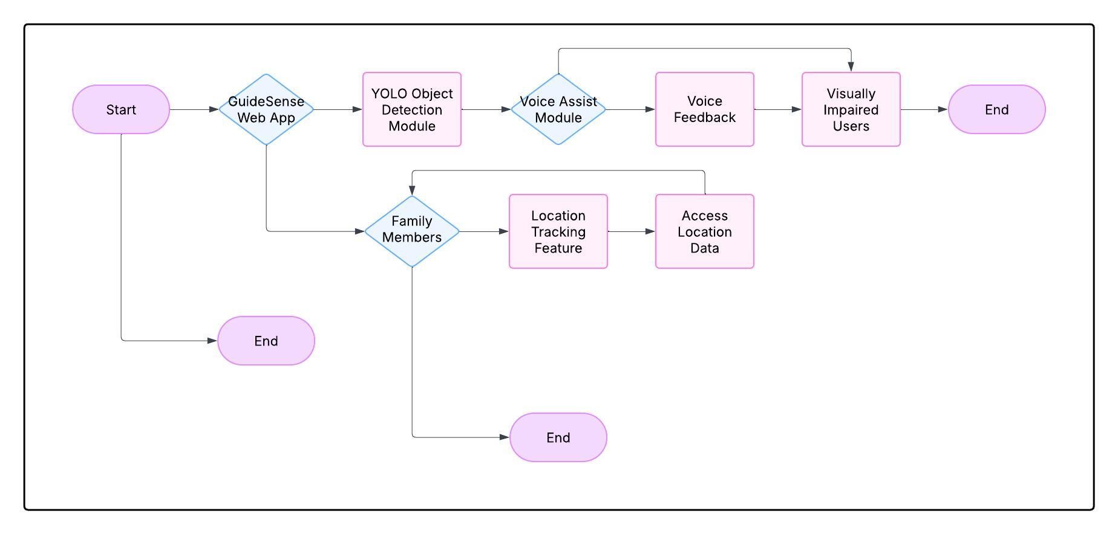
Context Diagram

Slide 20
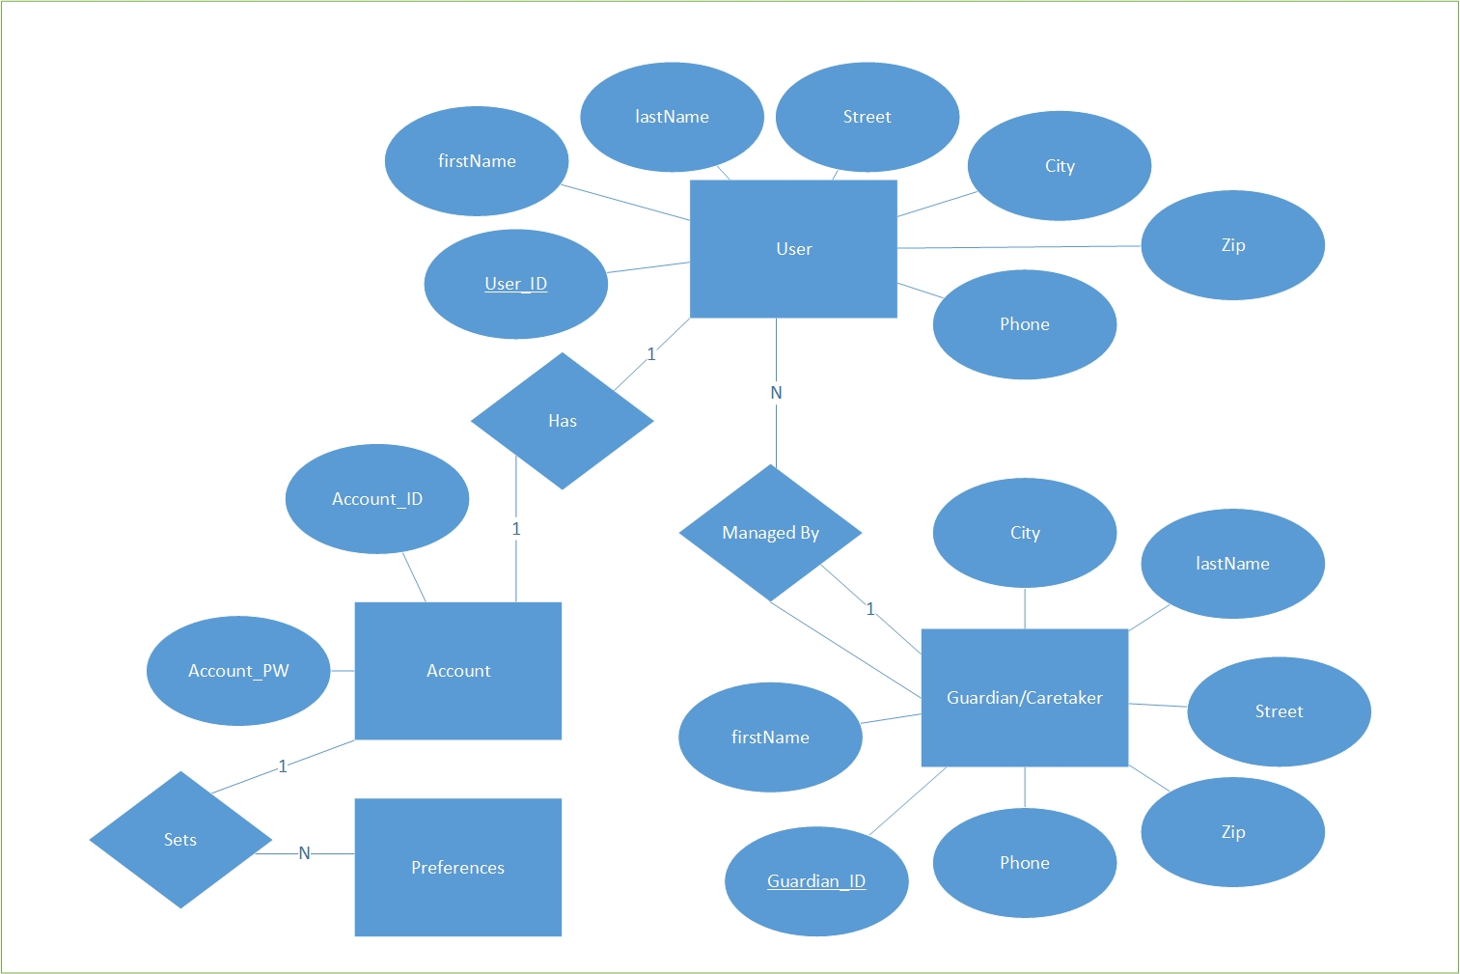
ER Diagram(improved)

Slide 21
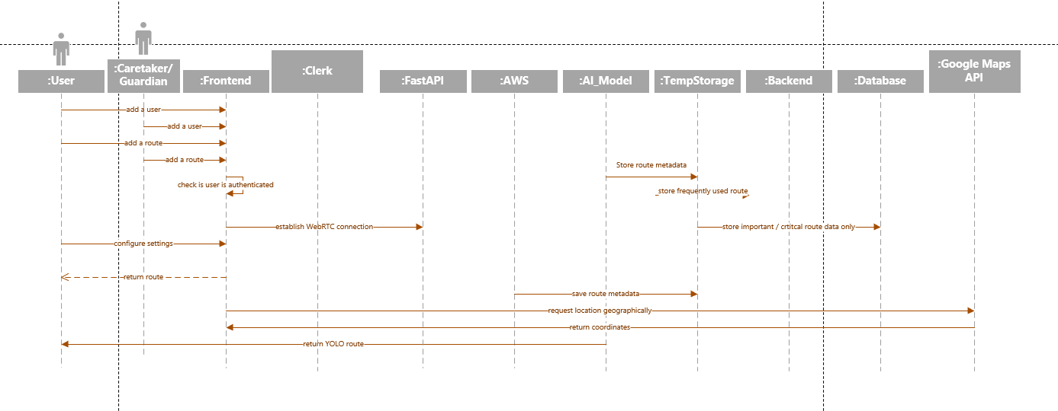
Sequence Diagram

Slide 22
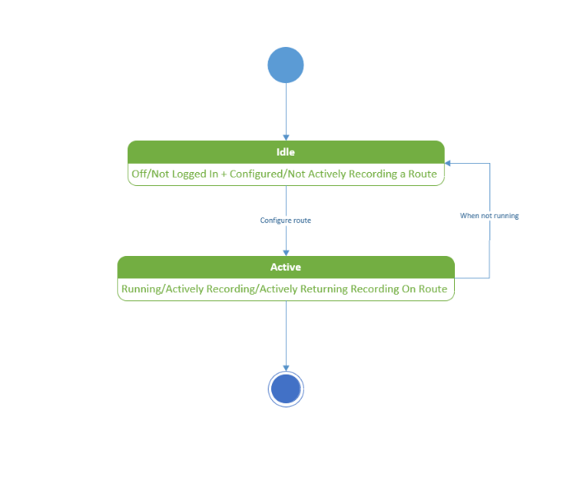
State Diagram

Slide 23
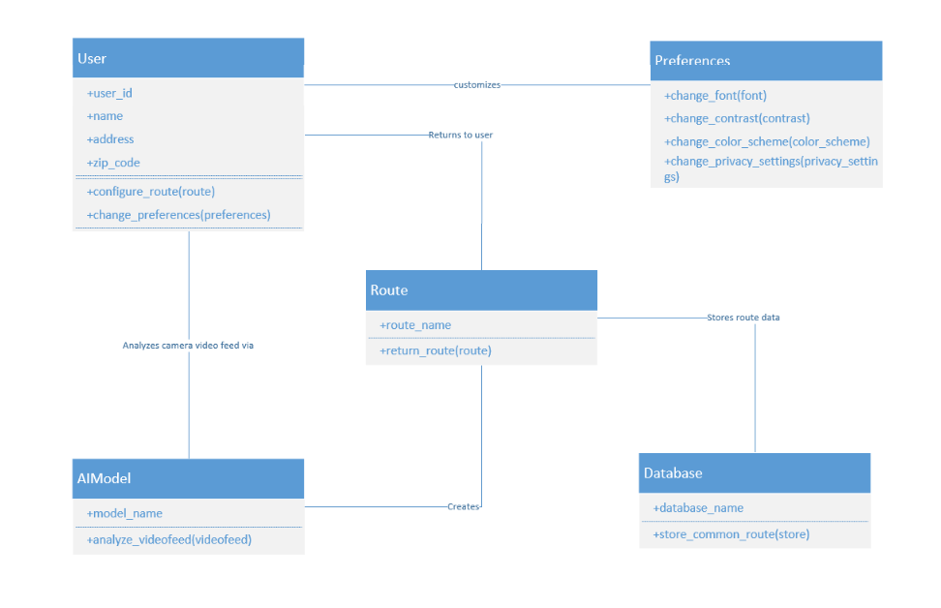
Class Diagram

Slide 24
Sprint 2 Recap
1
2
3
Improved detection model
Implemented Text-to-Speech functions
Completed technical paper (documentation)
4
Integrated Front-end and Back-end

Slide 25
Product Backlog(improved)
ID | Sprint | User Story / Technical Story | Acceptance Criteria | SP
US1 | 2 | As a visually impaired user, I want to receive audio alerts when potential obstacles are detected through my device camera, so that I can navigate safely in unfamiliar environments. | The FastAPI backend should process frames using the YOLO model and return a JSON object with detected obstacles or important objects (e.g., door, chair, or pedestrian), ensuring minimal delay for real-time assistance. | 5
US2 | 2 | As a visually impaired user, I want a single, easy-to-find button that allows me to capture video using my device's camera, so that I can receive audio descriptions of my surroundings to help me navigate safely. | The application must provide an accessible interface that allows visually impaired users to easily capture videos through the phone camera and receive real-time audio feedback on detected objects. | 8
US3 | 2 | As a visually impaired user, I want to hear descriptions of objects around me, so that I can understand my surroundings and move around safely. | The system should accurately identify objects in the user's surroundings and provide clear, real-time auditory descriptions through text-to-speech, ensuring the user can understand and navigate their environment safely | 8

Slide 26
Product Backlog
ID | Sprint | User Story / Technical Story | Acceptance Criteria | SP
US4 | 2 | As a visually impaired user, I want to store my data in the app’s frontend, so that I can interact with the application to track my information. | The frontend should allow users to store and display data in real-time, reflecting changes in the interface. | 3
US5 | 1 | As a visually impaired user, I want to securely sign up, log in, and manage my account, so that I can access personalized features within the app. | The user should be able to securely sign up, log in, manage their account, reset their password, and maintain their session, with proper error handling and redirection after authentication using Clerk | 8
US6 | 1 | As a visually impaired user, I want to enter address and receive navigation directions, so that I can easily find the route to my destination. | The user should be able to input the address, and the system should display the route using Google Maps, providing turn-by-turn navigation with estimated time of arrival and distance. | 8

Slide 27
Product Backlog
ID | Sprint | User Story / Technical Story | Acceptance Criteria | SP
TS1 | 1 | As a developer, I need to write test cases for Sprint 0 to ensure the implemented features are working as expected and meet the acceptance criteria. | All user stories and technical requirements from Sprint 1 should have corresponding test cases that cover positive, negative, and edge case scenarios. | 5
TS2 | 1 | As a developer, I need to write test cases for Sprint 1 to ensure the implemented features are working as expected and meet the acceptance criteria. | All user stories and technical requirements from Sprint 2 should have corresponding test cases that cover positive, negative, and edge case scenarios. | 5
TS3 | 2 | As a developer, I need to write test cases for Sprint 2 to ensure the implemented features are working as expected and meet the acceptance criteria. | All user stories and technical requirements from Sprint 3 should have corresponding test cases that cover positive, negative, and edge case scenarios. | 5
TS4 | 3 | As a developer, I need to write test cases for Sprint 3 to ensure the implemented features are working as expected and meet the acceptance criteria. | All user stories and technical requirements from Sprint 4 should have corresponding test cases that cover positive, negative, and edge case scenarios. | 5

Slide 28
Product Backlog(improved)
ID | Sprint | User Story / Technical Story | Acceptance Criteria | SP
TS4 | 2 | As a developer, I need to write a technical paper documenting the methodology, findings, and outcomes of our project, so that it can be shared with stakeholders, academic peers, or for publication purposes. | The technical paper should comprehensively document the project's problem, methodology, results, analysis, and conclusions, following a clear, structured format with proper citations and adhering to the required submission guidelines. | 5
TS5 | 1 | As a developer, I need to set up the MongoDB database according to the ER diagram, so that the data structure aligns with the application requirements, ensuring efficient storage and retrieval of user information. | The database should be set up according to the ER diagram with proper schema, indexing, and relationships | 5
TS6 | 2 | As a developer, I need to document the API endpoints and integrations for FastAPI, YOLO object detection, and Google Maps, so that the team can easily understand how to interact with the services and ensure smooth integration. | The API documentation should clearly describe all FastAPI endpoints, YOLO object detection integration, Google Maps functionality, include example requests and responses, and provide authentication details, error codes, and troubleshooting guidelines. | 5

Slide 29
Product Backlog(improved)
ID | Sprint | User Story / Technical Story | Acceptance Criteria | SP
TS7 | 1 | As a developer, I need to research and evaluate different AI models for real-time object detection and explore WebRTC and other methods for connecting the backend and frontend, so that we can select the most suitable technologies for our project’s requirements. | The research should evaluate various AI models for real-time object detection and communication methods like WebRTC, comparing performance, scalability, security, and deployment requirements, and provide a recommendation based on the project's needs. | 5
TS8 | 1 | As a developer, I need to create an diagrams(Architecture, Sequence, Class, ER, State, Context) for the entire product, which includes all core components, services, and interactions such as the frontend, backend, external APIs, database, and third-party integrations, so that the overall structure and flow of the system are clearly understood and can be implemented effectively. | The architecture diagram should clearly represent all major components (functional and non-functional) of the product, their interactions, data flow, and error handling mechanisms, using a standard tool for easy understanding and team review. | 13

Slide 30
Product Backlog(improved)
ID | Sprint | User Story / Technical Story | Acceptance Criteria | SP
TS9 | 1 | As the Project Manager, I want to ensure seamless coordination between technical components and stakeholders, So that the system meets both user needs and technical specifications | The system should facilitate regular communication between stakeholders and the development team, track progress against project goals, ensure alignment between user needs and technical specifications, and maintain clear documentation for all key technical components and requirements | 1
TS10 | 2 | As a Developer, I want to review and update the diagrams | Diagrams should be upto date and should be reviewed with the team | 1

Slide 31
Sprint Summary

Slide 32
Sprint 1 User Stories
ID | User Story / Technical Story | Acceptance Criteria | SP | status
US5 | As a vision impacted user, I want to securely sign up, log in, and manage my account so that I can access personalized features. | The user should be able to securely sign up, log in, manage their account, reset their password, and maintain their session, with proper error handling and redirection after authentication using Clerk | 8 | Completed
US6 | As a vision impacted user, I want to enter a source and destination and receive navigation directions so that I can easily find the best route to my destination. | The user should be able to input a source and destination address, and the system should display the best route using Google Maps, providing turn-by-turn navigation with estimated time of arrival and distance. | 8 | Completed
TS1 | As a developer, I need to write test cases for Sprint 0 to ensure the implemented features are working as expected and meet the acceptance criteria. | All user stories and technical requirements from Sprint 1 should have corresponding test cases that cover positive, negative, and edge case scenarios. | 5 | Completed

Slide 33
Sprint 1 User Stories
ID | User Story / Technical Story | Acceptance Criteria | SP | Status
TS7 | As a developer, I need to research and evaluate different AI models for real-time object detection and explore WebRTC and other methods for connecting the backend and frontend, so that we can select the most suitable technologies for our project’s requirements. | The research should evaluate various AI models for real-time object detection and communication methods like WebRTC, comparing performance, scalability, security, and deployment requirements, and provide a recommendation based on the project's needs. | 5 | Completed
TS8 | As a developer, I need to create an diagrams(Architecture, Sequence, Class, ER, State, Context) for the entire product, which includes all core components, services, and interactions such as the frontend, backend, external APIs, database, and third-party integrations, so that the overall structure and flow of the system are clearly understood and can be implemented effectively. | The architecture diagram should clearly represent all major components (functional and non-functional) of the product, their interactions, data flow, and error handling mechanisms, using a standard tool for easy understanding and team review. | 13 | Completed

Slide 34
Sprint 1 User Stories
ID | User Story / Technical Story | Acceptance Criteria | SP | Status
TS7 | As a developer, I need to research and evaluate different AI models for real-time object detection and explore WebRTC and other methods for connecting the backend and frontend, so that we can select the most suitable technologies for our project’s requirements. | The research should evaluate various AI models for real-time object detection and communication methods like WebRTC, comparing performance, scalability, security, and deployment requirements, and provide a recommendation based on the project's needs. | 5 | Completed
TS9 | As the Project Manager, I want to ensure seamless coordination between technical components and stakeholders, So that the system meets both user needs and technical specifications. | The system should facilitate regular communication between stakeholders and the development team, track progress against project goals, ensure alignment between user needs and technical specifications, and maintain clear documentation for all key technical components and requirements | 1 | Completed
Total Committed Story Points on Sprint 1: 45

Slide 35
Sprint 1 committed 45 story points and completed 45 story points.

Slide 36
Sprint 2 User Stories
ID | User Story / Technical Story | Acceptance Criteria | SP | status
US1 | As a visually impaired user, I want to receive real-time alerts when objects are detected through my phone camera | The FastAPI backend should process frames using the YOLO model and return a JSON object with detected obstacles or important objects (e.g., door, chair, or pedestrian), ensuring minimal delay for real-time assistance. | 5 | Completed
US2 | As a visually impaired user, I want an intuitive interface that allows me to easily capture images using my phone camera, so that the system can analyze the surroundings and help me navigate safely. | The application must provide an accessible interface that allows visually impaired users to easily capture images through the phone camera and receive real-time audio feedback on detected objects. | 8 | Completed
US3 | As a visually impaired user, I want the system to describe detected objects in my surroundings through text-to-speech, so that I can receive real-time auditory feedback and safely navigate my environment. | The system should accurately identify objects in the user's surroundings and provide clear, real-time auditory descriptions through text-to-speech, ensuring the user can understand and navigate their environment safely | 8 | Completed

Slide 37
Sprint 2 User Stories
ID | User Story / Technical Story | Acceptance Criteria | SP | status
TS6 | As a developer, I need to document the API endpoints and integrations for FastAPI, YOLO object detection, and Google Maps so that the team can easily understand how to interact with the services and ensure smooth integration | The API documentation should clearly describe all FastAPI endpoints, YOLO object detection integration, Google Maps functionality, include example requests and responses, and provide authentication details, error codes, and troubleshooting guidelines. | 5 | Completed
TS10 | As a Developer, I want to review and update the diagrams | Diagrams should be upto date and should be reviewed with the team | 1 | Inccomplete
TS4 | As a developer, I need to write a technical paper documenting the methodology, findings, and outcomes of our project so that it can be shared with stakeholders, academic peers, or for publication purposes. | The technical paper should comprehensively document the project's problem, methodology, results, analysis, and conclusions, following a clear, structured format with proper citations and adhering to the required submission guidelines. | 5 | Completed

Slide 38
Sprint 2 User Stories
ID | User Story / Technical Story | Acceptance Criteria | SP | status
TS3 | As a developer, I need to write test cases for Sprint 2 to ensure the implemented features are working as expected and meet the acceptance criteria. | All user stories and technical requirements from Sprint 3 should have corresponding test cases that cover positive, negative, and edge case scenarios. | 5 | Completed
US4 | As a user, I want to store my data in the app’s frontend and see the results reflected immediately so that I can interact with the application in real-time and track my information. | the frontend should allow users to store and display data in real-time, reflecting changes immediately in the app interface. | 2 | Completed
Total Committed Story Points on Sprint 2: 39

Slide 39
Sprint 2 committed 39 story points and completed 38 story points.

Slide 40
Sprint 3 – Sprint Backlog
ID | User Story / Technical Story | Acceptance Criteria | SP | Status
TS12 | As a developer, I need to create an AWS account for the project, so that we can deploy and host backend services, machine learning models, and other cloud-based components in a secure and scalable environment. | An AWS account should be successfully created, with access credentials securely stored and shared with authorized team members. | 2 | Completed
TS13 | As a developer, I need to deploy the backend and model code on an AWS EC2 instance, so that the application can run continuously on the cloud and handle real-time requests from users. | The backend and model code should be successfully deployed and running on the EC2 instance, accessible via the instance’s public IP or domain, and verified through test requests. | 8 | Completed
TS14 | As a developer, I need to create a comprehensive deployment and installation manual for the project so that other team members and future developers can easily set up the environment, deploy the application, and maintain the system. | The manual should include clear, step-by-step instructions for environment setup, dependencies installation, code deployment, and running the application, and should be accessible to the entire team. | 8 | Completed

Slide 41
Sprint 3 – Sprint Backlog
ID | User Story / Technical Story | Acceptance Criteria | SP | Status
TS15 | As a developer, I need to deploy the project’s database on an AWS RDS server so that we can ensure secure, scalable, and managed database access for our application across all environments. | The database should be successfully created and deployed on the RDS server, with appropriate security groups, credentials configured, and connectivity verified from the application backend. | 3 | Incomplete
US7 | As a visually impaired user, I want to receive real-time audio updates about my surroundings so that I can navigate safely and independently. | The frontend and backend should work together to provide real-time object detection, user-specific responses, and data storage, with all core features functioning smoothly and verified end-to-end through user interaction. | 8 | Completed
US8 | As a visually impaired user, I want a simple and accessible UI to input my source and destination so that I can easily receive navigation directions using Google Maps and move safely and independently. | The UI should allow users to enter source and destination locations, and upon submission, display route information and initiate navigation using Google Maps integration in an accessible format. | 5 | Completed

Slide 42
Sprint 3 – Sprint Backlog
ID | User Story / Technical Story | Acceptance Criteria | SP | Status
TS4 | As a developer, I need to write test cases for Sprint 3 to ensure the implemented features are working as expected and meet the acceptance criteria. | All user stories and technical requirements from Sprint 4 should have corresponding test cases that cover positive, negative, and edge case scenarios. | 5 | Completed
TS16 | As a developer, I need to draft a technical paper that documents the design, architecture, implementation details, challenges faced, and results of the project so that we can clearly present our work for academic or professional review. | The technical paper should include sections on problem statement, methodology, system architecture, technology stack, implementation details, challenges, results, and future work, and it should be well-structured and ready for submission or presentation. | 5 | Completed
US9 | As a visually impaired user, I want to be able to connect with other users and grant them access to control my app temporarily, so that they can assist me in navigating or using certain features remotely when I need help. | The system should allow a user to securely share access with a trusted user, enabling them to view and interact with key controls in real-time, with the ability to revoke access at any time. | 5 | Incomplete
Total Committed Story Points on Sprint 3: 49

Slide 43
Sprint 3 – Burndown Chart(improved)
Sprint 3 committed 49 story points and completed 41 story points.
Notes:
Sprint burndown was completed as shown above. The total sprint commitment was 45 total story points. All issues in the sprint were completed.

Slide 44
Sprint 3 Test Cases(improved)
ID | Story ID | Test Case | Expected Result | Status
1 | TS12 | Verify that a developer can successfully create a new AWS account with root user credentials | A new AWS account is created with a confirmed email address, secure password, and multi-factor authentication (MFA) enabled for the root user. The developer receives confirmation of successful account creation and can access the AWS Management Console. | Passed
2 | TS13 | Verify that the backend and model code can be successfully deployed on an appropriately configured EC2 instance | EC2 instance launches with proper configuration (correct type, security groups, IAM role). Backend and model code deploy successfully with all dependencies. Application initializes without errors, with logs confirming proper startup of all components | Passed
3 | TS14 | Verify that the deployment and installation manual contains all necessary steps and information | Manual includes complete setup instructions for environment configuration, application deployment, and system maintenance with accurate commands, dependencies, and configuration settings. | Passed

Slide 45
Sprint 3 Test Cases(improved)
ID | Story ID | Test Case | Expected Result | Status
4 | US7 | Verify that the application correctly identifies and communicates relevant objects and obstacles in the user's surroundings | Application accurately detects obstacles, landmarks, and potential hazards in the user's environment and provides clear, timely audio descriptions that match what's actually present. | Passed
5 | US7 | Verify that audio updates are delivered in a clear, timely, and non-disruptive manner | Audio notifications are delivered with appropriate volume, clarity, and frequency. Critical alerts are prioritized, and the user can easily understand the information without becoming overwhelmed or confused by excessive updates. | Passed
6 | US8 | Verify that visually impaired users can easily input their source and destination using accessibility features | UI elements are properly labeled for screen readers, voice input works correctly, and all input fields are navigable using keyboard shortcuts. Users can successfully enter locations without visual cues. | Passed
7 | US8 | Verify that navigation directions from Google Maps are delivered in an accessible format | Navigation directions are converted to clear audio instructions that provide timely guidance at appropriate intervals. Turn-by-turn directions include distance information and warning for upcoming turns. | Passed

Slide 46
Sprint 3 – Team Velocity & Committed Ratio
Out of a total 49 committed story points, 41 story points were completed. The committed ratio is 84%.

Slide 47
Retrospective – Sprint 3
What went well?
What need to improve?
Action Items
Integrated API on time
Team meetings were short but effective
Clear prioritization of tasks and features
Comprehensive documentation covering all use cases
Successfully implemented professor's feedback
Completed core development features on schedule
Effective code synchronization and review process before merging code
Better planning and timeline management
Ensuring everyone joins sprint meetings regularly
Avoiding last-minute merging of features
Setting up initial API infrastructure earlier in the process
Standardizing the installation manual to make it more simplistic with clearer steps
Implement weekly timeline check-ins to assess progress against milestones
Send calendar invites with automatic reminders 1 hour before meetings
Establish a code freeze policy 24-48 hours before sprint end
Test installation instructions with a team member who wasn't involved in writing them

Slide 48
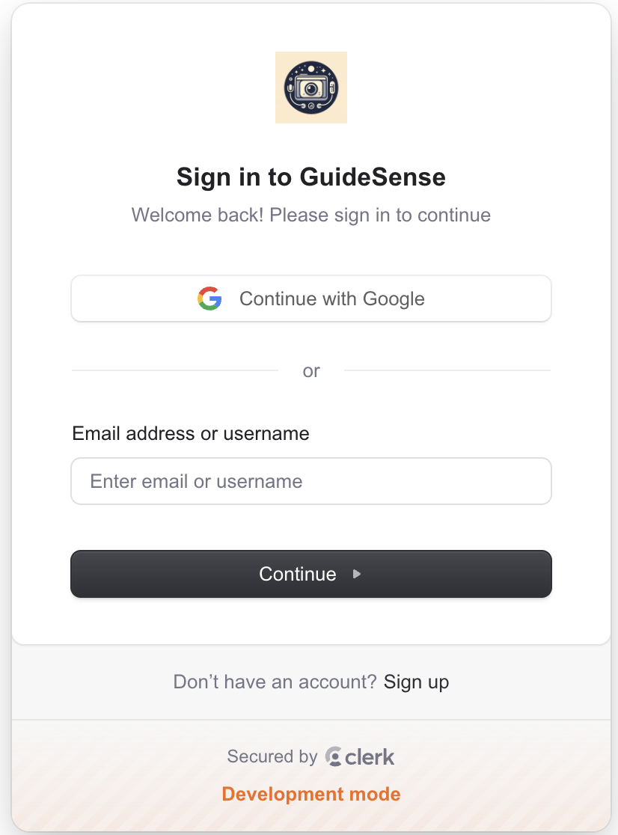
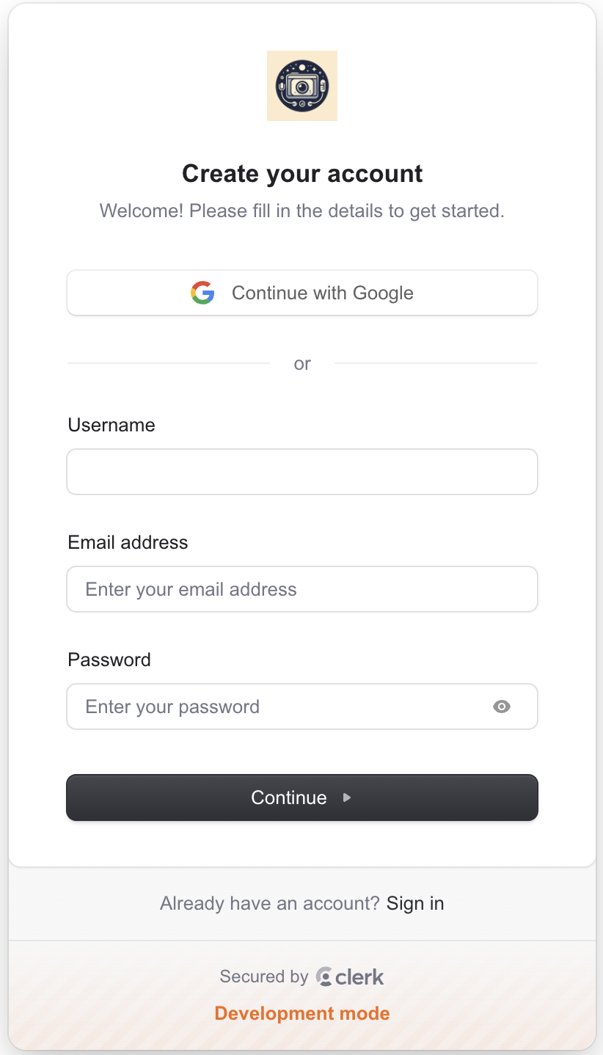
Project Demo

Slide 49
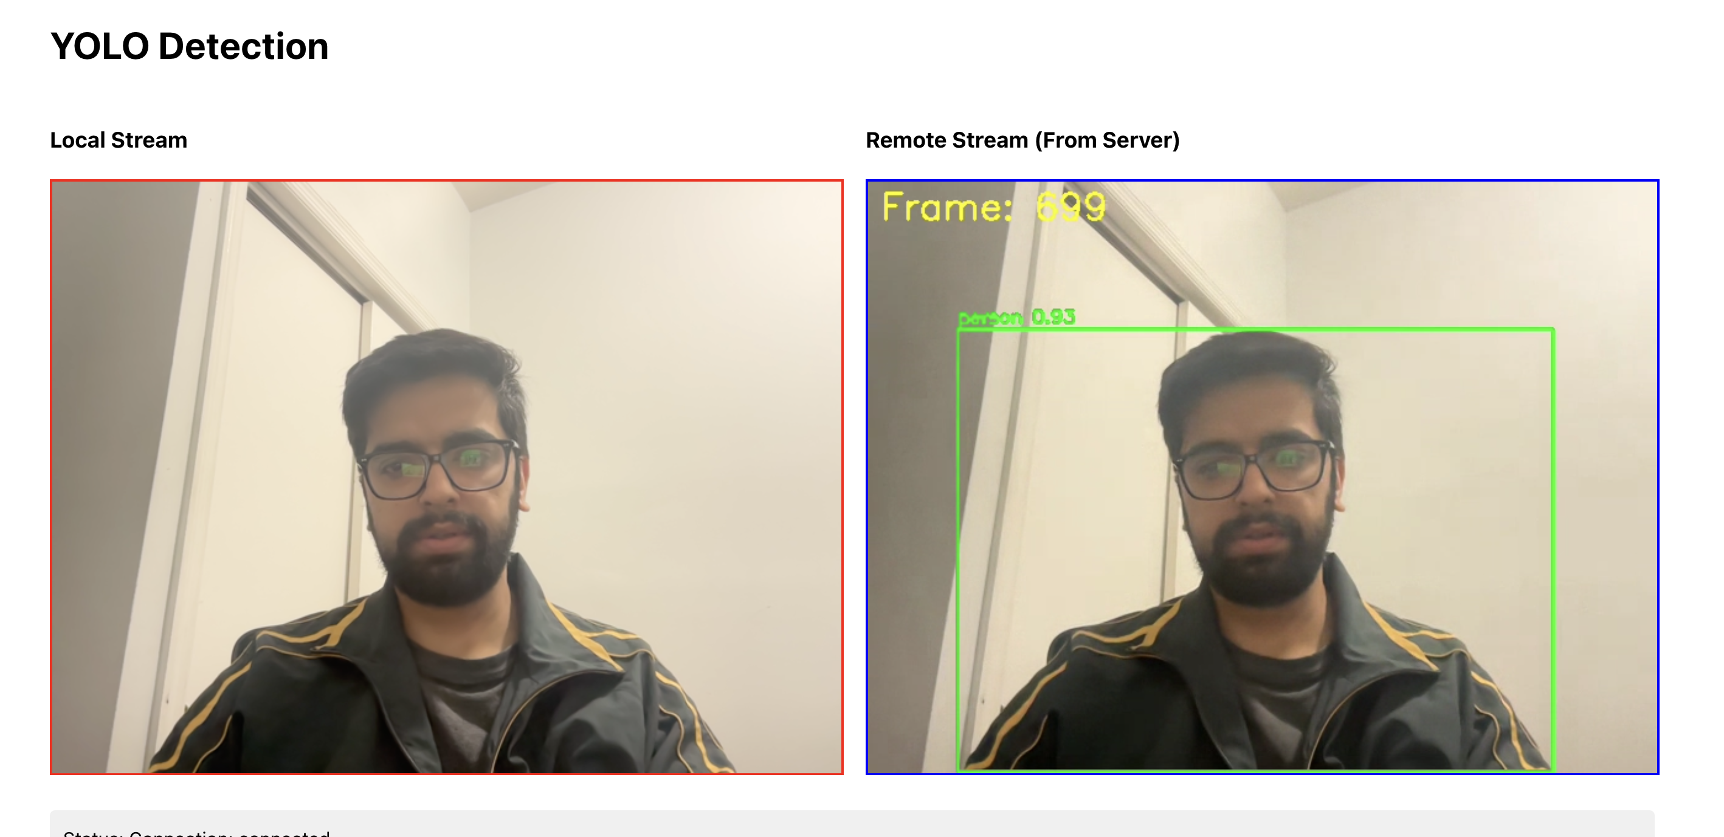
Project Demo

Slide 50
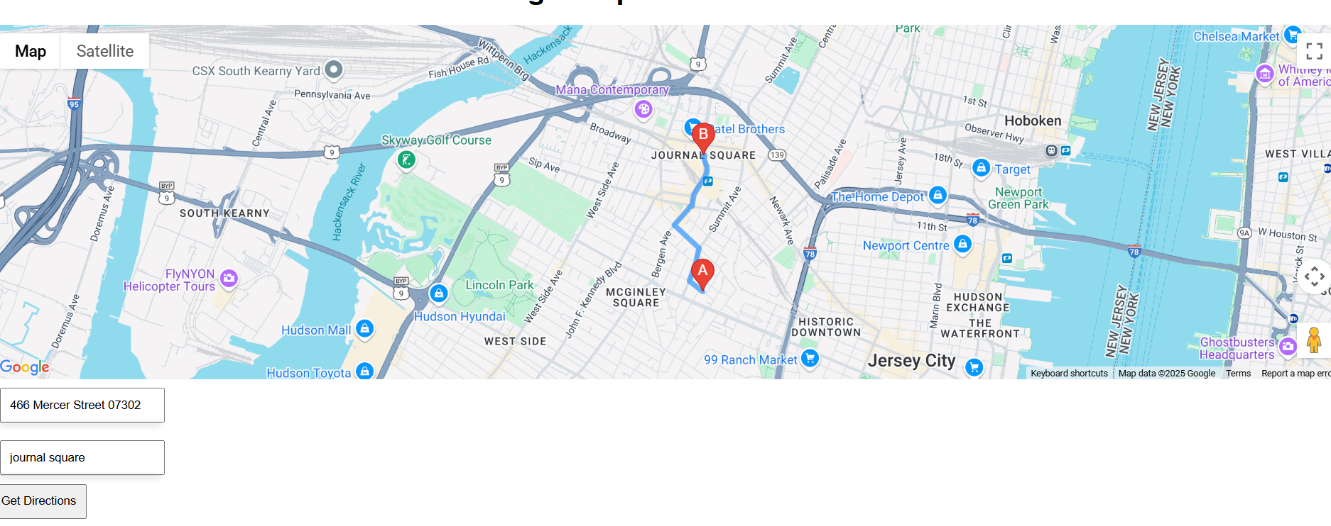
Project Demo

Slide 51
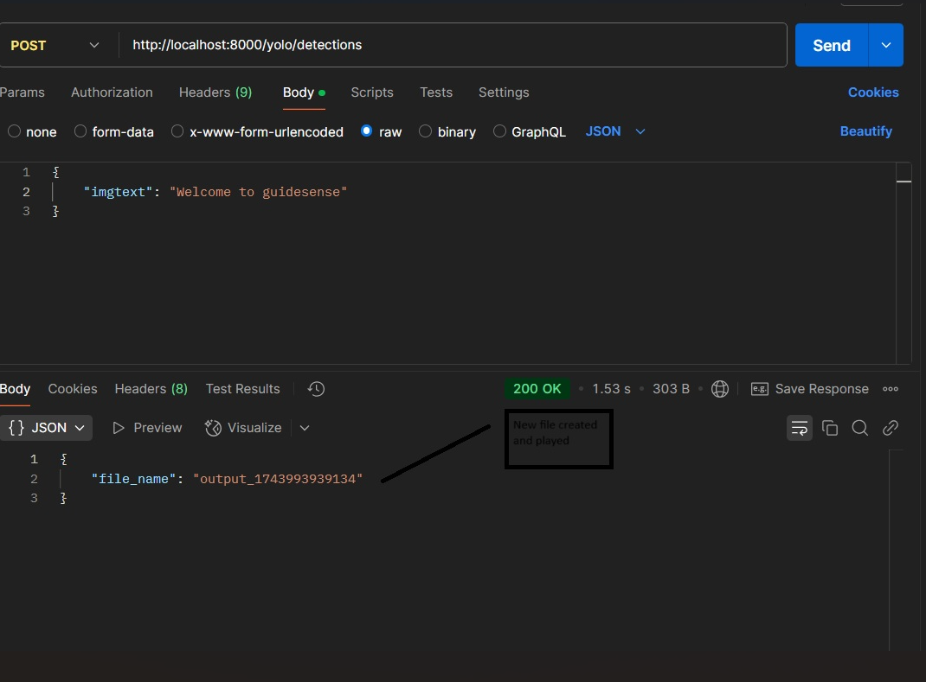
Project Demo

Slide 52
Backend API
Detections API (to detect messages from frontend and pass it to text to speech API)
detections: async (req, res) => {
try {
console.log(req.body);
// Extract detected objects and add to accumulated set
if (req.body.detections && req.body.detections.length > 0) {
req.body.detections.forEach(det => {
accumulatedDetections.add(det.class_name);
});
}
const currentTime = Date.now();
// Check if cooldown period has passed
if (currentTime - lastSpeechTime >= speechCooldown && accumulatedDetections.size > 0) {
// Find new objects that weren't in the last announcement
const newObjects = [...accumulatedDetections].filter(obj => !lastAnnouncedDetections.has(obj));
// Find objects that disappeared
const removedObjects = [...lastAnnouncedDetections].filter(obj => !accumulatedDetections.has(obj));

Slide 53
Backend API
// Only generate speech if there are changes
if (newObjects.length > 0 || removedObjects.length > 0) {
let detectionText = "";
if (newObjects.length > 0) {
detectionText += `I now see ${newObjects.join(', ')}. `;
}
if (removedObjects.length > 0) {
detectionText += `I no longer see ${removedObjects.join(', ')}.`;
}
// Generate speech
const result = await yoloService.detections(JSON.parse('{"imgtext":"' + detectionText + '"}'));
// Update last announced set to current set
lastAnnouncedDetections = new Set(accumulatedDetections);
// Reset the timer and accumulated detections
lastSpeechTime = currentTime;
return res.status(200).json({file_name: result});

Slide 54
Backend API
} else {
// If we have the same objects as before, don't generate speech
lastSpeechTime = currentTime; // Still reset the timer
return res.status(200).json({message: "No change in detected objects"});
}
} else {
// If we're in cooldown period, just acknowledge
return res.status(200).json({message: "Detection added to queue"});
}
} catch (error) {
return res
.status(500)
.json({ message: "An error occurred" });
}
},

Slide 55
Live Application Demo
https://youtu.be/mZWwf9uV3u4

Slide 56
https://github.com/htmw/2025S-Power-Anger/wiki
Project Wikipage Link

